Slide 1
Variables and Sequential Programming

Slide 2
Variables in Machine Language
There are no variables in machine language
There are no objects
There is no "dynamic memory allocation"
There are constants like 42, '*', and 123
We have a limited number of named registers in the CPU
There is one big array of memory locations
Memory is like one big array in C
Memory addresses are like pointers in C

Slide 3
CDC8512 Variables
PC
CMP
Mode
A0
A1
A2
A3
0x00
<=>
0
0x00
0x00
0x00
0x00
X0
X1
X2
X3
Address Registers (4) are for load / store addresses
X registers (4) are for data and computations and for load / store data
Data memory (255) holds variables when we want to reuse a register
0x00
0x00
0x00
0x00
Instruction Memory
Data Memory
0x00
00000000
0x00
0x00
0x01
00000000
0x01
0x00
0x02
00000000
0x02
0x00
0x03
00000000
0x03
0x00
0x04
00000000
0x04
0x00
0x05
00000000
0x05
0x00

Slide 4
Load / Store
PC
CMP
Mode
A0
A1
A2
A3
0x00
<=>
0
0x00
0x00
0x00
0x00
What
Next?
X0
X1
X2
X3
PC – Program Counter
CMP – Result of most recent comparison instruction
Mode – Error indicator
A and X registers shown in hex
Instruction memory is shown in base-2 for easy decoding
Data memory shows in hex – will usually contain ASCII
0x00
0x00
0x00
0x00
Instruction Memory
Data Memory
0x00
00000000
0x00
0x00
0x01
00000000
0x01
0x00
0x02
00000000
0x02
0x00
0x03
00000000
0x03
0x00
0x04
00000000
0x04
0x00
0x05
00000000
0x05
0x00

Slide 5
CDC8512 Architecture
PC
CMP
Mode
A0
A1
A2
A3
0x00
<=>
0
0x00
0x00
0x00
0x00
X0
X1
X2
X3
A program
0x00
0x00
0x00
0x00
0x00
10000110
Set register X2 to the next byte
The letter 'H'
Set A2 to 0 (Stores X2 at 0x00)
Set register X2 to the next byte
The letter 'i'
Add 1 to A2 (Stores X2 at 0x01)
Halt and Print
0x00
0x00
0x01
01001000
0x01
0x00
0x02
01000010
0x02
0x00
0x03
10000110
0x03
0x00
0x04
01101001
0x04
0x00
0x05
01010010
0x05
0x00
0x06
00000001
0x06
0x00

Slide 6
CDC8512 Architecture
PC
CMP
Mode
A0
A1
A2
A3
0x00
<=>
0
0x00
0x00
0x00
0x00
X0
X1
X2
X3
Start the program
Out first instruction is a two byte instruction
0x00 Sets X2 to the byte at 0x01
Advances the PC by 2
The byte at 0x01 is the ASCII letter for 'H' (0x68)
0x00
0x00
0x00
0x00
0x00
10000110
0x00
0x00
0x01
01001000
0x01
0x00
0x02
01000010
0x02
0x00
0x03
10000110
0x03
0x00
0x04
01101001
0x04
0x00
0x05
01010010
0x05
0x00
0x06
00000001
0x06
0x00

Slide 7
CDC8512 Architecture
PC
CMP
Mode
A0
A1
A2
A3
0x02
<=>
0
0x00
0x00
0x00
0x00
X0
X1
X2
X3
Start the program
Out first instruction is a two byte instruction
0x00 Sets X2 to the byte at 0x01
Advances the PC by 2
The byte at 0x01 is the ASCII letter for 'H' (0x68)
So 'H' is loaded into X2 and the PC is set to 0x02
0x00
0x00
0x48
0x00
0x00
10000110
0x00
0x00
0x01
01001000
0x01
0x00
0x02
01000010
0x02
0x00
0x03
10000110
0x03
0x00
0x04
01101001
0x04
0x00
0x05
01010010
0x05
0x00
0x06
00000001
0x06
0x00

Slide 8
CDC8512 Architecture
PC
CMP
Mode
A0
A1
A2
A3
0x02
<=>
0
0x00
0x00
0x00
0x00
X0
X1
X2
X3
We load the instruction at 0x02
Which sets A0 to 0 and as a side effect, stores the contents of X2 into data location 0x00
0x00
0x00
0x48
0x00
0x00
10000110
0x00
0x48
0x01
01001000
0x01
0x00
0x02
01000010
0x02
0x00
0x03
10000110
0x03
0x00
0x04
01101001
0x04
0x00
0x05
01010010
0x05
0x00
0x06
00000001
0x06
0x00

Slide 9
CDC8512 Architecture
PC
CMP
Mode
A0
A1
A2
A3
0x03
<=>
0
0x00
0x00
0x00
0x00
X0
X1
X2
X3
We load the instruction at 0x02
Which sets A0 to 0 and as a side effect, stores the contents of X2 into data location 0x00
Then the PC is updated to 0x03
0x00
0x00
0x48
0x00
0x00
10000110
0x00
0x48
0x01
01001000
0x01
0x00
0x02
01000010
0x02
0x00
0x03
10000110
0x03
0x00
0x04
01101001
0x04
0x00
0x05
01010010
0x05
0x00
0x06
00000001
0x06
0x00

Slide 10
CDC8512 Architecture
PC
CMP
Mode
A0
A1
A2
A3
0x03
<=>
0
0x00
0x00
0x00
0x00
X0
X1
X2
X3
The instruction at 0x03 is a two byte instruction
0x03 Sets X2 to the byte at 0x04
Advances the PC by 2
The byte at 0x04 is the ASCII letter for 'i' (0x89)
So 'i' is loaded into X2
0x00
0x00
0x69
0x00
0x00
10000110
0x00
0x48
0x01
01001000
0x01
0x00
0x02
01000010
0x02
0x00
0x03
10000110
0x03
0x00
0x04
01101001
0x04
0x00
0x05
01010010
0x05
0x00
0x06
00000001
0x06
0x00

Slide 11
CDC8512 Architecture
PC
CMP
Mode
A0
A1
A2
A3
0x05
<=>
0
0x00
0x00
0x00
0x00
X0
X1
X2
X3
The instruction at 0x03 is a two byte instruction
0x03 Sets X2 to the byte at 0x04
Advances the PC by 2
The byte at 0x04 is the ASCII letter for 'i' (0x89)
So 'i' is loaded into X2
And the PC is set to 0x05
0x00
0x00
0x69
0x00
0x00
10000110
0x00
0x48
0x01
01001000
0x01
0x00
0x02
01000010
0x02
0x00
0x03
10000110
0x03
0x00
0x04
01101001
0x04
0x00
0x05
01010010
0x05
0x00
0x06
00000001
0x06
0x00

Slide 12
CDC8512 Architecture
PC
CMP
Mode
A0
A1
A2
A3
0x05
<=>
0
0x00
0x00
0x01
0x00
X0
X1
X2
X3
We load the instruction at 0x05
Which adds 1 to A0 and as a side effect, stores the contents of X2 into data location 0x00
Then the PC is updated to 0x06
0x00
0x00
0x69
0x00
0x00
10000110
0x00
0x48
0x01
01001000
0x01
0x69
0x02
01000010
0x02
0x00
0x03
10000110
0x03
0x00
0x04
01101001
0x04
0x00
0x05
01010010
0x05
0x00
0x06
00000001
0x06
0x00

Slide 13
CDC8512 Architecture
PC
CMP
Mode
A0
A1
A2
A3
<=>
0
0x00
0x00
0x01
0x00
X0
X1
X2
X3
We load the instruction at 0x06
Which is a "Halt and Print" instruction
The memory contains a zero terminated string
0x68 0x89 0x00
From the ASCII table, our output is "Hi"
0x00
0x00
0x69
0x00
0x00
10000110
0x00
0x48
0x01
01001000
0x01
0x69
0x02
01000010
0x02
0x00
0x03
10000110
0x03
0x00
0x04
01101001
0x04
0x00
0x05
01010010
0x05
0x00
0x06
00000001
0x06
0x00

Slide 14
Review
PC
CMP
Mode
A0
A1
A2
A3
0x06
<=>
0
0x00
0x00
0x01
0x00
X0
X1
X2
X3
0x00
0x00
0x69
0x00
Hi
0x00
10000110
Set register X2 to the next byte
The letter 'H'
Set A2 to 0 (Stores X2 at 0x00)
Set register X2 to the next byte
The letter 'i'
Add 1 to A2 (Stores X2 at 0x01)
Halt and Print
0x00
0x48
0x01
01001000
0x01
0x69
0x02
01000010
0x02
0x00
0x03
10000110
0x03
0x00
0x04
01101001
0x04
0x00
0x05
01010010
0x05
0x00
0x06
00000001
0x06
0x00

Slide 15
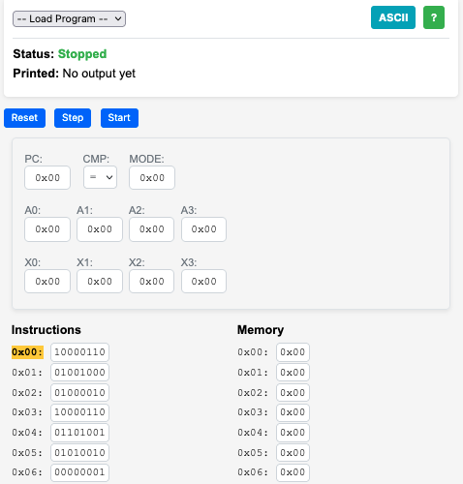
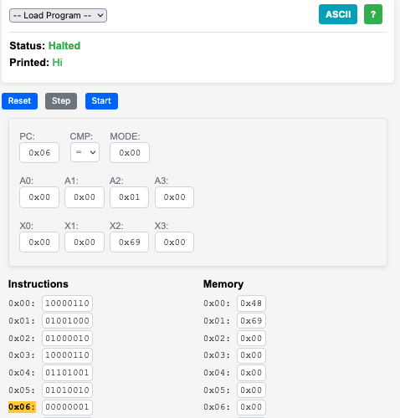
Hi

Slide 16
CDC 8512 – Assembly Language
https://www.ca4e.com/cdc8512/documentation.html

Slide 17
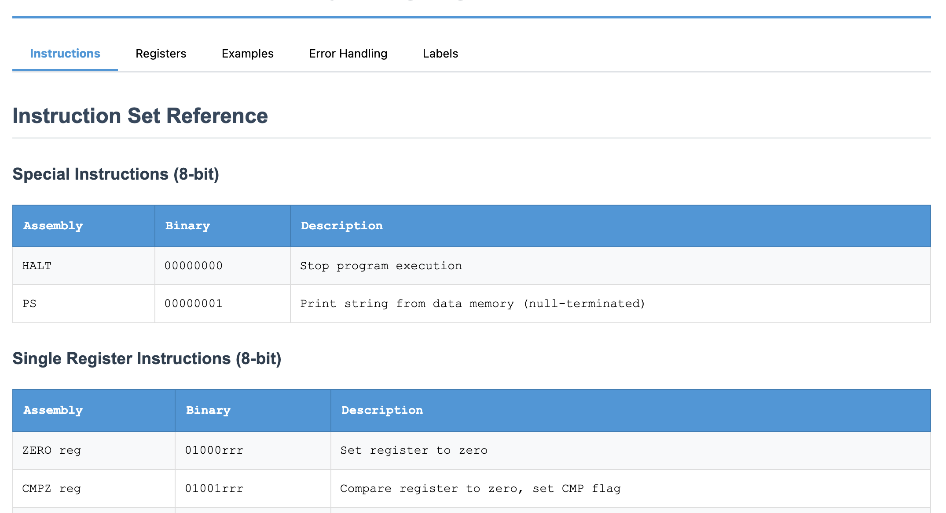
CDC8512 CPU Reference

Slide 18
Set a Register
SET X3, 'C' ; Set X3 to the value for ASCII C (67)
SET A3, 0 ; Set A3 to zero and store 'C' in data memory location 0x00
SET A1, 0 ; Set A1 to zero and load memory location 0x00 into X0
MOV X1, X3 ; Copy X3 to X1
SET A3, 0x01 ; Set A3 to 1 and store 'C' in data memory location 0x01
SET X3, 0x00 ; Set X3 to zero
SET A3, 0x02 ; Set A3 to 0x02 and store X3 into location 0x02
; Note constants can be decimal (0-255) hexadecimal (0x00-0xff) or a single
; ASCII character in single quotes 'a'

Slide 19
Register Arithmetic
; This will print: Hello
SET X3, 'H' ; Set X3 to the value for ASCII H
SET A3, 0 ; Set A3 to zero and store 'H' in data memory location 0x00
SET X3, 'e' ; Set X3 to 'e'
INC A3 ; Add 1 to A3 and store 'e' in location 0x01
SET X3, 'l' ; Set X3 to 'l'
ADD A3, 1 ; Add 1 to A3 and store 'l' in location 0x02
INC A3 ; Add 1 to A3 and store 'l' in location 0x03
ADD X3, 4 ; Add 4 to X3 so that it is now 'p'
DEC X3 ; Subtract 1 from X3 so that it is now 'o'
INC A3 ; Add 1 to A3 and store '0' in location 0x04
SET X3, 0 ; Set X3 to integer zero
INC A3 ; Add 1 to A3 and store integer 0 in location 0x05
PS ; Print memory starting at data address 0 as an
; ASCII string, stopping when a zero is encountered

Slide 20
Comparison and Jumps
JP 0x12 ; Set the PC (Program Counter) to an instruction address and
; continue execution at that address
CMP X3, 42 ; Compare a register to a constant and set comparison status
JE 0x12 ; Jump to the instruction address if comparison status is =
JG 0x12 ; Jump to the instruction address if comparison status is >
JL 0x12 ; Jump to the instruction address if comparison status is <

Slide 21
Miscellaneous Instructions
PS # Print data area starting at specified data address
# stopping when an integer 0 byte is encountered
HALT # Stop Execution

Slide 22
Summary
SX3 A3 # Copy a register to another
SX3 42 # Set a register to an 8-bit
INC A1 # Add 1 to a register
DEC X3 # Subtract 1 from a register
ADD X1, 42 # Add a constant to a register
SUB X3, 42 # Subtract a constant from a register
JP 0x12 # Jump to a label
CMP X3, 42 # Compare a register to a constant and set comparison status
JE 0x12 # Jump to the address if CMP was equal
JG 0x12 # Jump to the address if CMP was >
JL 0x12 # Jump to the address if CMP was <
PS # Print data area as character string
DI # Dump Instruction area in hex 16 per line
DD # Dump data area in hex 16 per
HALT # Stop Execution

Slide 23
CDC 8512 – Machine Language
(a.k.a. the zeros and ones of programming)

Slide 24
CDC 8512 - Assembly / Machine Code
SET X2, 'H'
ZERO A2
SET X2, 'i'
INC A2
PS
HALT
10000110
01001000 'H'
01000010
10000110
01101001 'i'
01010010
00000001
00000000

Slide 25
Single Register 8-bit Instruction
Zero Register
Register
ZERO A2
0
1
0
0
0
0
1
0
Op Code
Register
Number
0 = A register
1 = X register

Slide 26
Set Register to Constant (16-bit instruction)
Set Register
SET X2,'H'
1
0
0
0
0
1
1
0
0
1
0
0
1
0
0
0
Op Code
ASCII for 'H'
Register
Number
0 = A register
1 = X register

Slide 27
Single Register 8-Bit Instruction
INC A2 # Increment A2
Decrement Register
Register
0
1
0
1
0
0
1
0
Op Code
Register
Number
0 = A register
1 = X register

Slide 28
Print and Halt Instructions
0
0
0
0
0
0
0
1
PS # Print Memory
HALT # Stop the CPU
0
0
0
0
0
0
0
0

Slide 29
Two Register Instruction
Register
Copy
Destination
Register
Source
Register
MV A1,X3 ; Copy A1 to X3
1
1
0
0
1
1
1
1
0 = A register
1 = X register
Register
Number
Register
Number
0 = A register
1 = X register

Slide 30
CDC8512 Emulator in JavaScript
// 5-bit patterns (bits 7-3)
else if ((instruction >> 3) === 0x08) { // 01000xxx - ZERO
const register = instruction & 0x07;
const regName = this.getRegisterName(register);
this.cpu[regName] = 0;
// CDC 6500 load/store architecture:
if (regName === 'a0') {
this.cpu.x0 = this.cpu.memory[this.cpu.a0];
} else if (regName === 'a1') {
this.cpu.x1 = this.cpu.memory[this.cpu.a1];
} else if (regName === 'a2') {
this.cpu.memory[this.cpu.a2] = this.cpu.x2;
} else if (regName === 'a3') {
this.cpu.memory[this.cpu.a3] = this.cpu.x3;
}
pcIncrement = 1;
}

Slide 31
Emulators for Fun

Slide 32
Building Emulators for Historical CPUs
It is not all that difficult to build an emulator for an older (simpler) CPU
Modern processors on our phones and computers are so fast that JavaScript in a browser can emulate historical machine code faster than the original hardware
The computer / phone / browser graphics are also far better
And it can be great fun

Slide 33
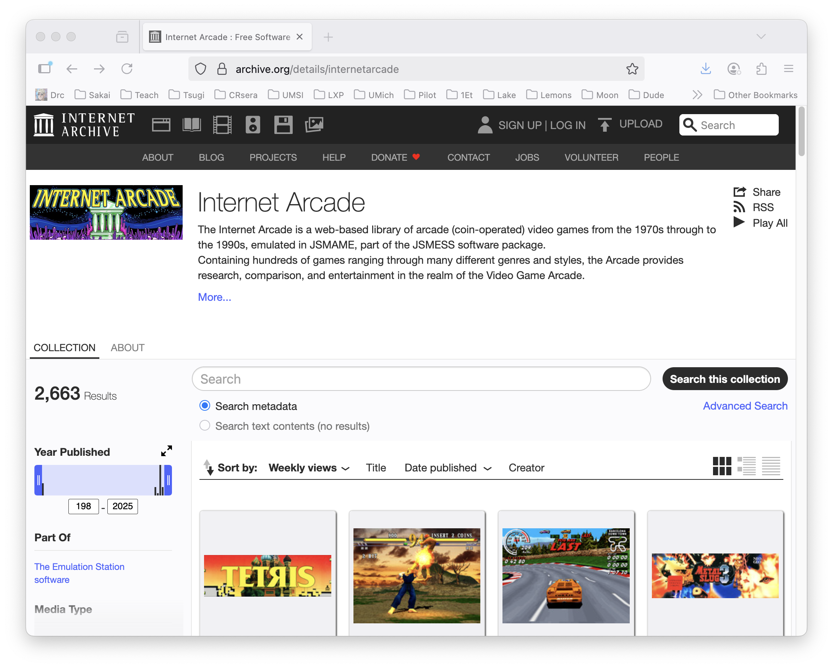
Archive.org: Internet Arcade

Slide 34
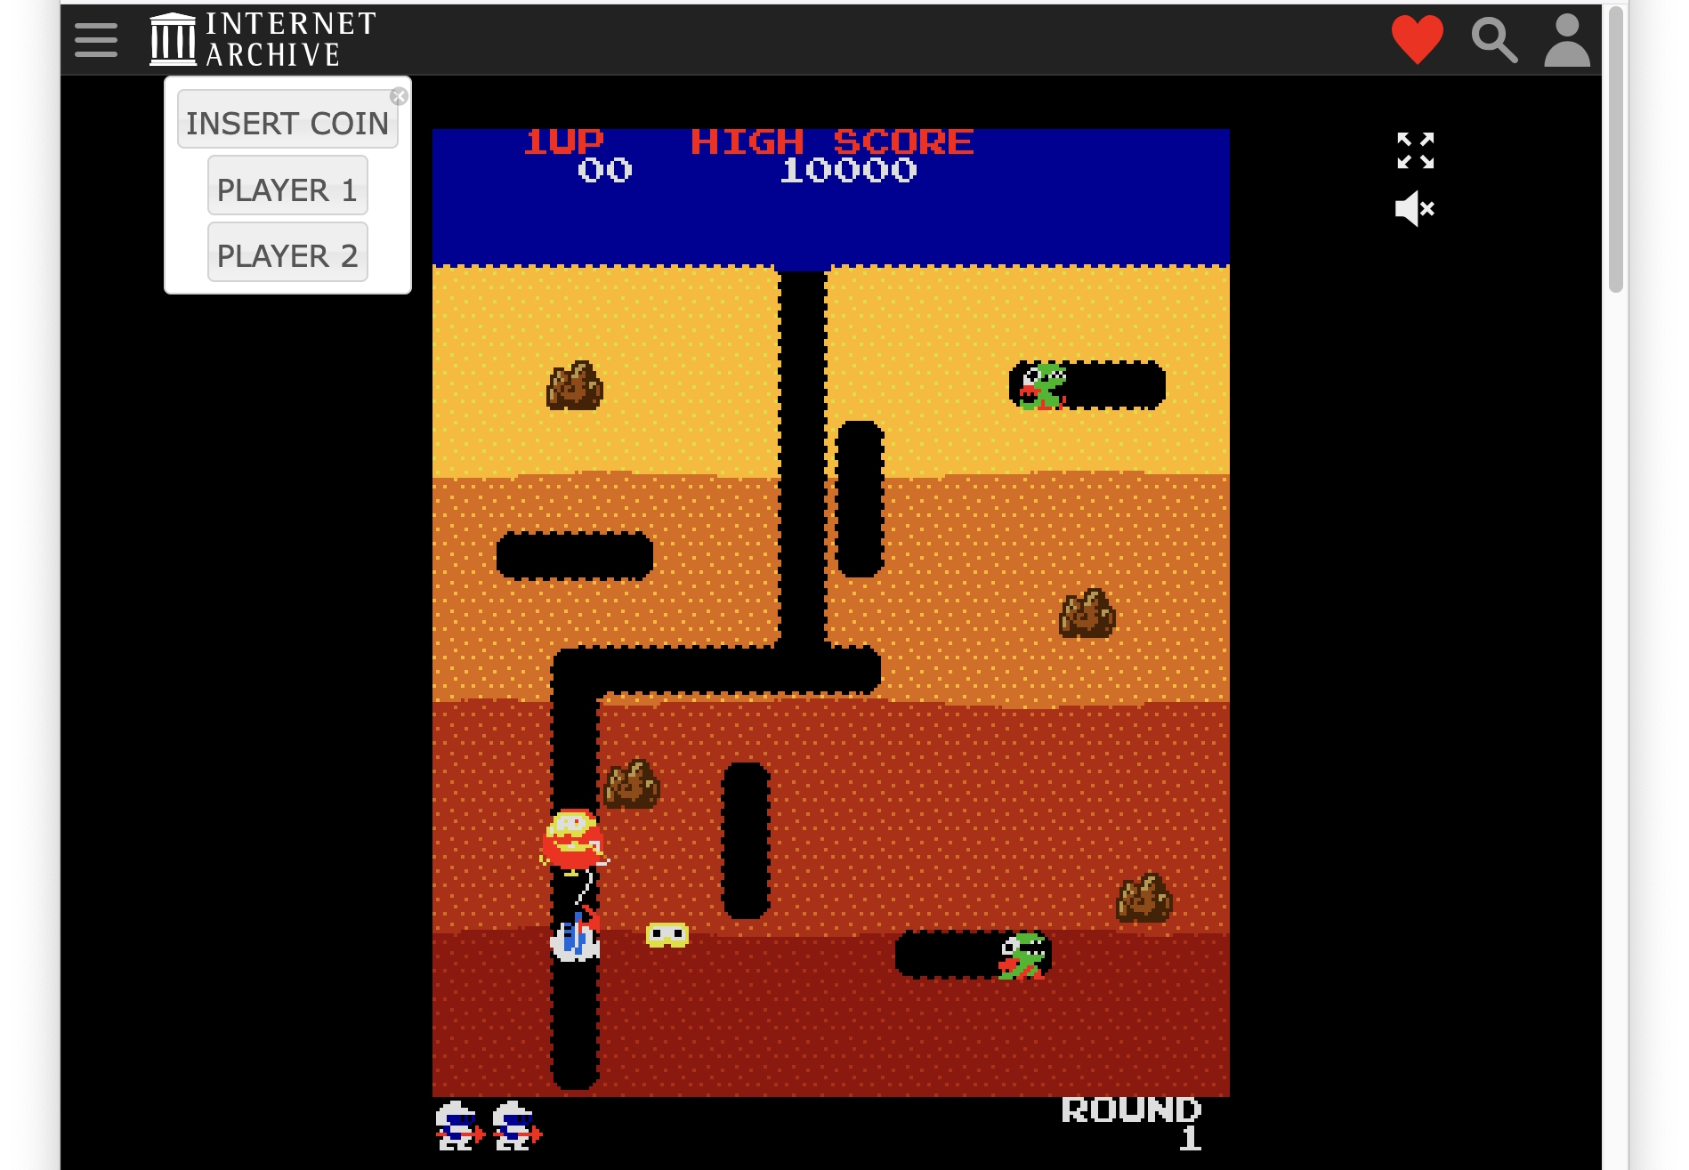
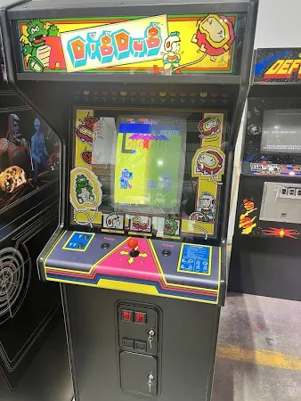
Game: Dig Dug

Slide 35
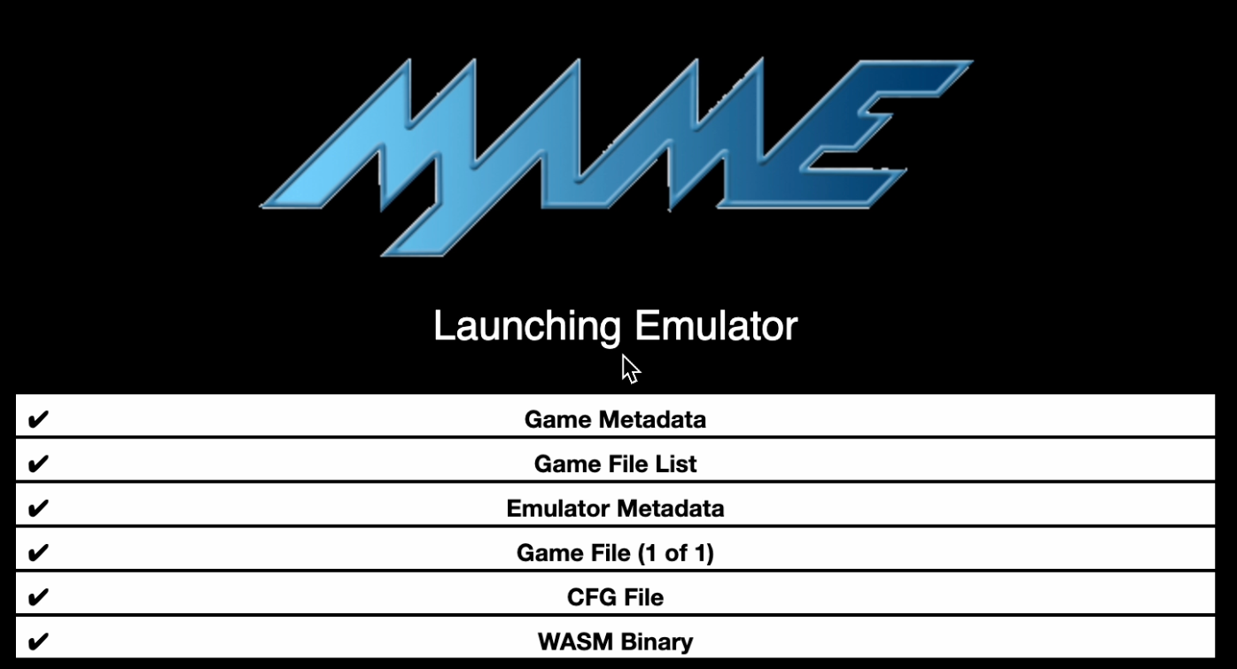
Dig Dug Startup – JSMAME Emulator

Slide 36
CPU Evolution
Why we invented our own super simple processor to learn.

Slide 37
Apple Computer Processors over time
MOS 6502 - Apple II – 1977 - 1993
Motorola MC68000 – Macintosh 1984-1994
IBM PowerPC – Macintosh 1994 – 2006
Intel x86 – Macintosh (2006-2020)
Samsung ARM – iPhone (2007-2009)
Apple ARM – iPhone (2010-Present)
Apple ARM – Macintosh (2020-Present)
Apple currently redesigns their CPUs based on workload over time – Image Processing / Audio / Video / Gaming / Artificial Intelligence

Slide 38
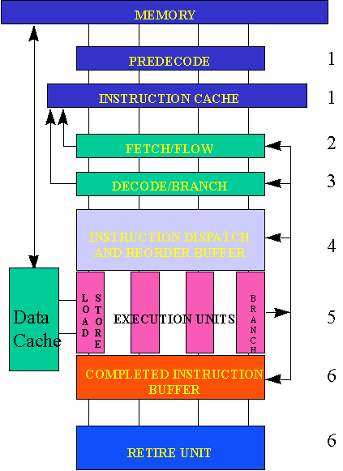
Reading: Post-Risc Architecture
https://cse.msu.edu/~enbody/postrisc/postrisc2.htm

Slide 39
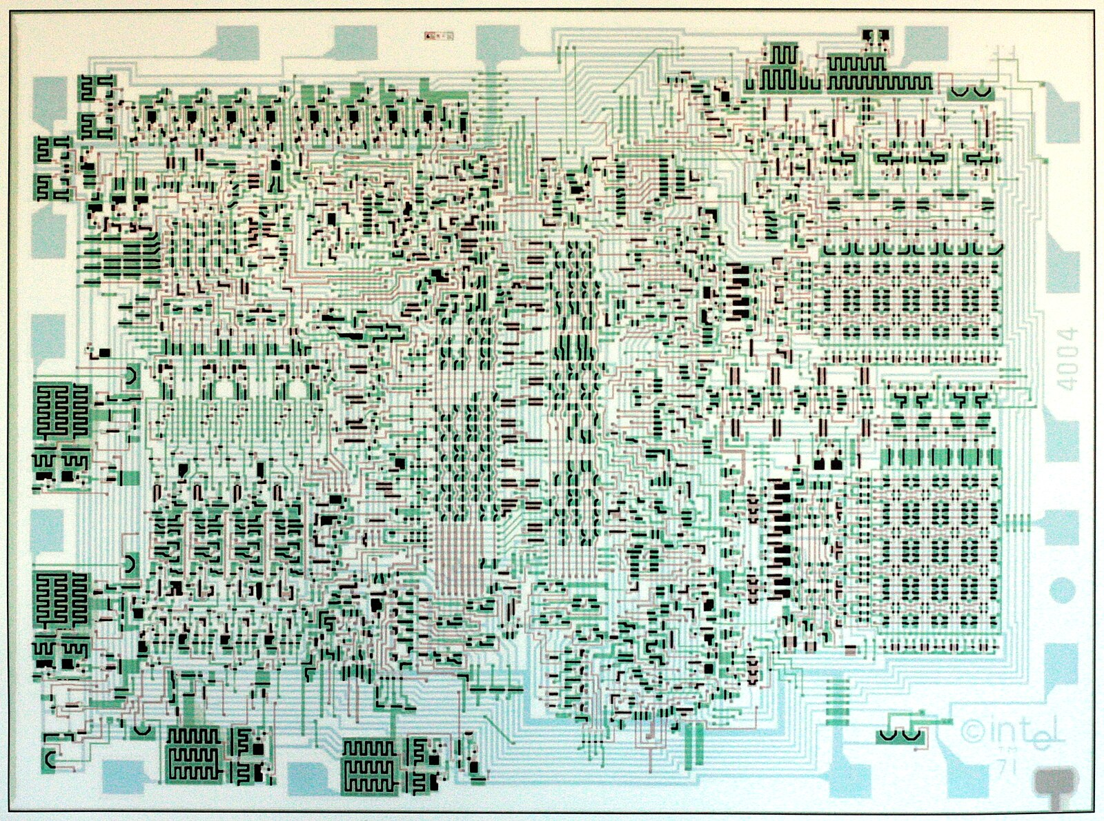
Reading: Intel 4004
https://www.4004.com/
http://e4004.szyc.org/
http://e4004.szyc.org/iset.html
http://e4004.szyc.org/emu/

Slide 40
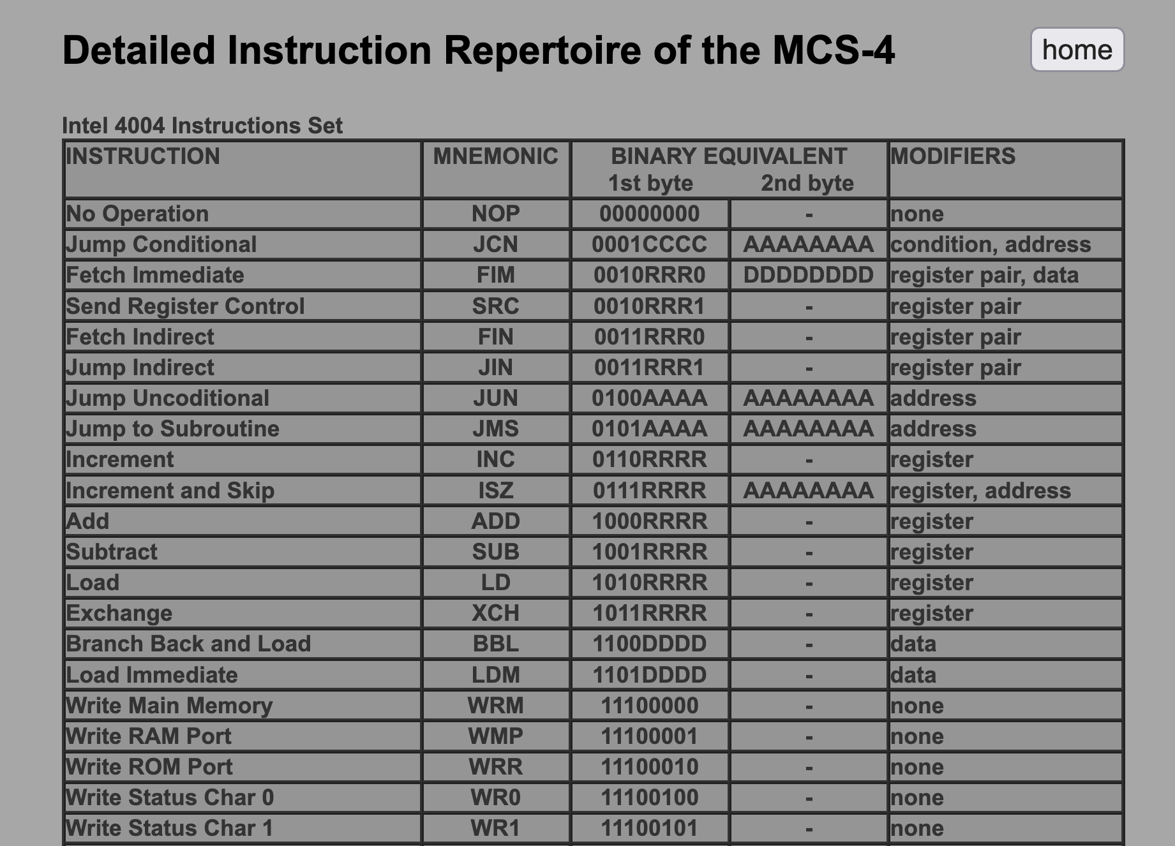
http://e4004.szyc.org/iset.html

Slide 41
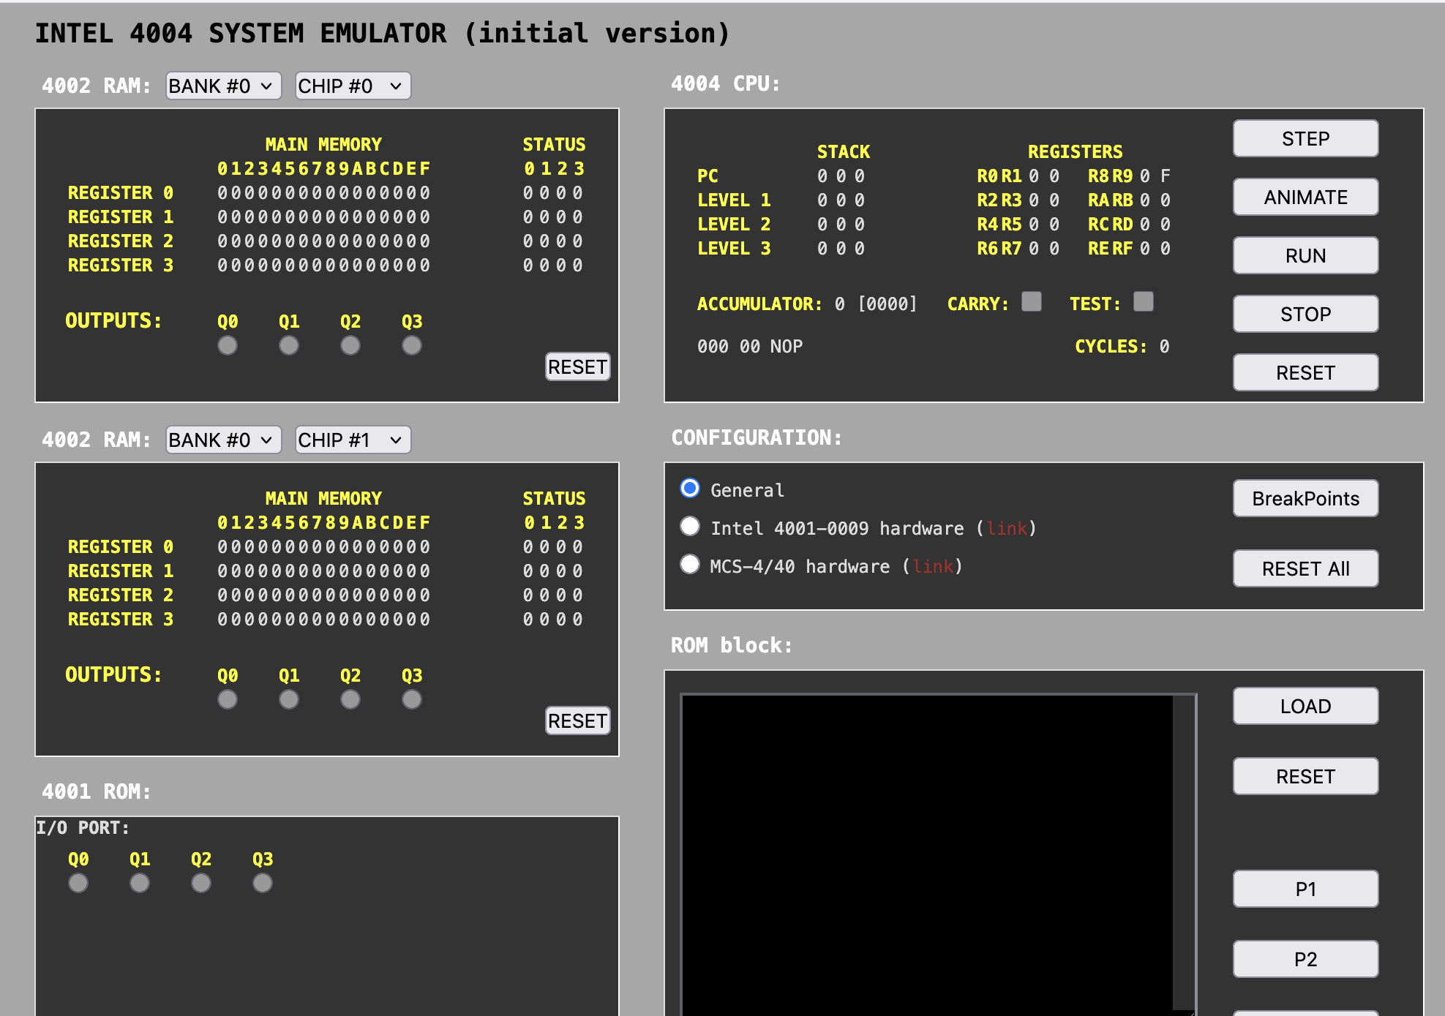
http://e4004.szyc.org/emu/

Slide 42
WASM – Web Assembly
There is a machine language emulator built into browsers called Web Assembly
For a wide range of software, compiling to WASM and running in JavaScript is enough
WASM is a different syntax than most Assembly languages – but it still compiles to a binary-machine code
C Programming for Everybody (www.cc4e.com) C Playground compiles C to WASM and then runs the WASM in the user's browser

Slide 43
WASM Hello World
;; Hello World WASM Example
(module
(import "console" "log" (func $log (param i32 i32)))
(memory 1)
(data (i32.const 0) "Hello, World!")
(func $main (result i32)
(call $log (i32.const 0) (i32.const 13))
(i32.const 42)
)
(export "main" (func $main))
)
00000000: 00 61 73 6d 01 00 00 00 01 0a 02 60 02 7f 7f 00 |.asm.......`....|
00000010: 60 00 01 7f 02 0f 01 07 63 6f 6e 73 6f 6c 65 03 |`.......console.|
00000020: 6c 6f 67 00 00 03 02 01 01 05 03 01 00 01 07 11 |log.............|
00000030: 02 06 6d 65 6d 6f 72 79 02 00 04 6d 61 69 6e 00 |..memory...main.|
00000040: 01 0a 0c 01 0a 00 41 00 41 0d 10 00 41 2a 0b 0b |......A.A...A*..|
00000050: 13 01 00 41 00 0b 0d 48 65 6c 6c 6f 2c 20 57 6f |...A...Hello, Wo|
00000060: 72 6c 64 21 |rld!|

Slide 44
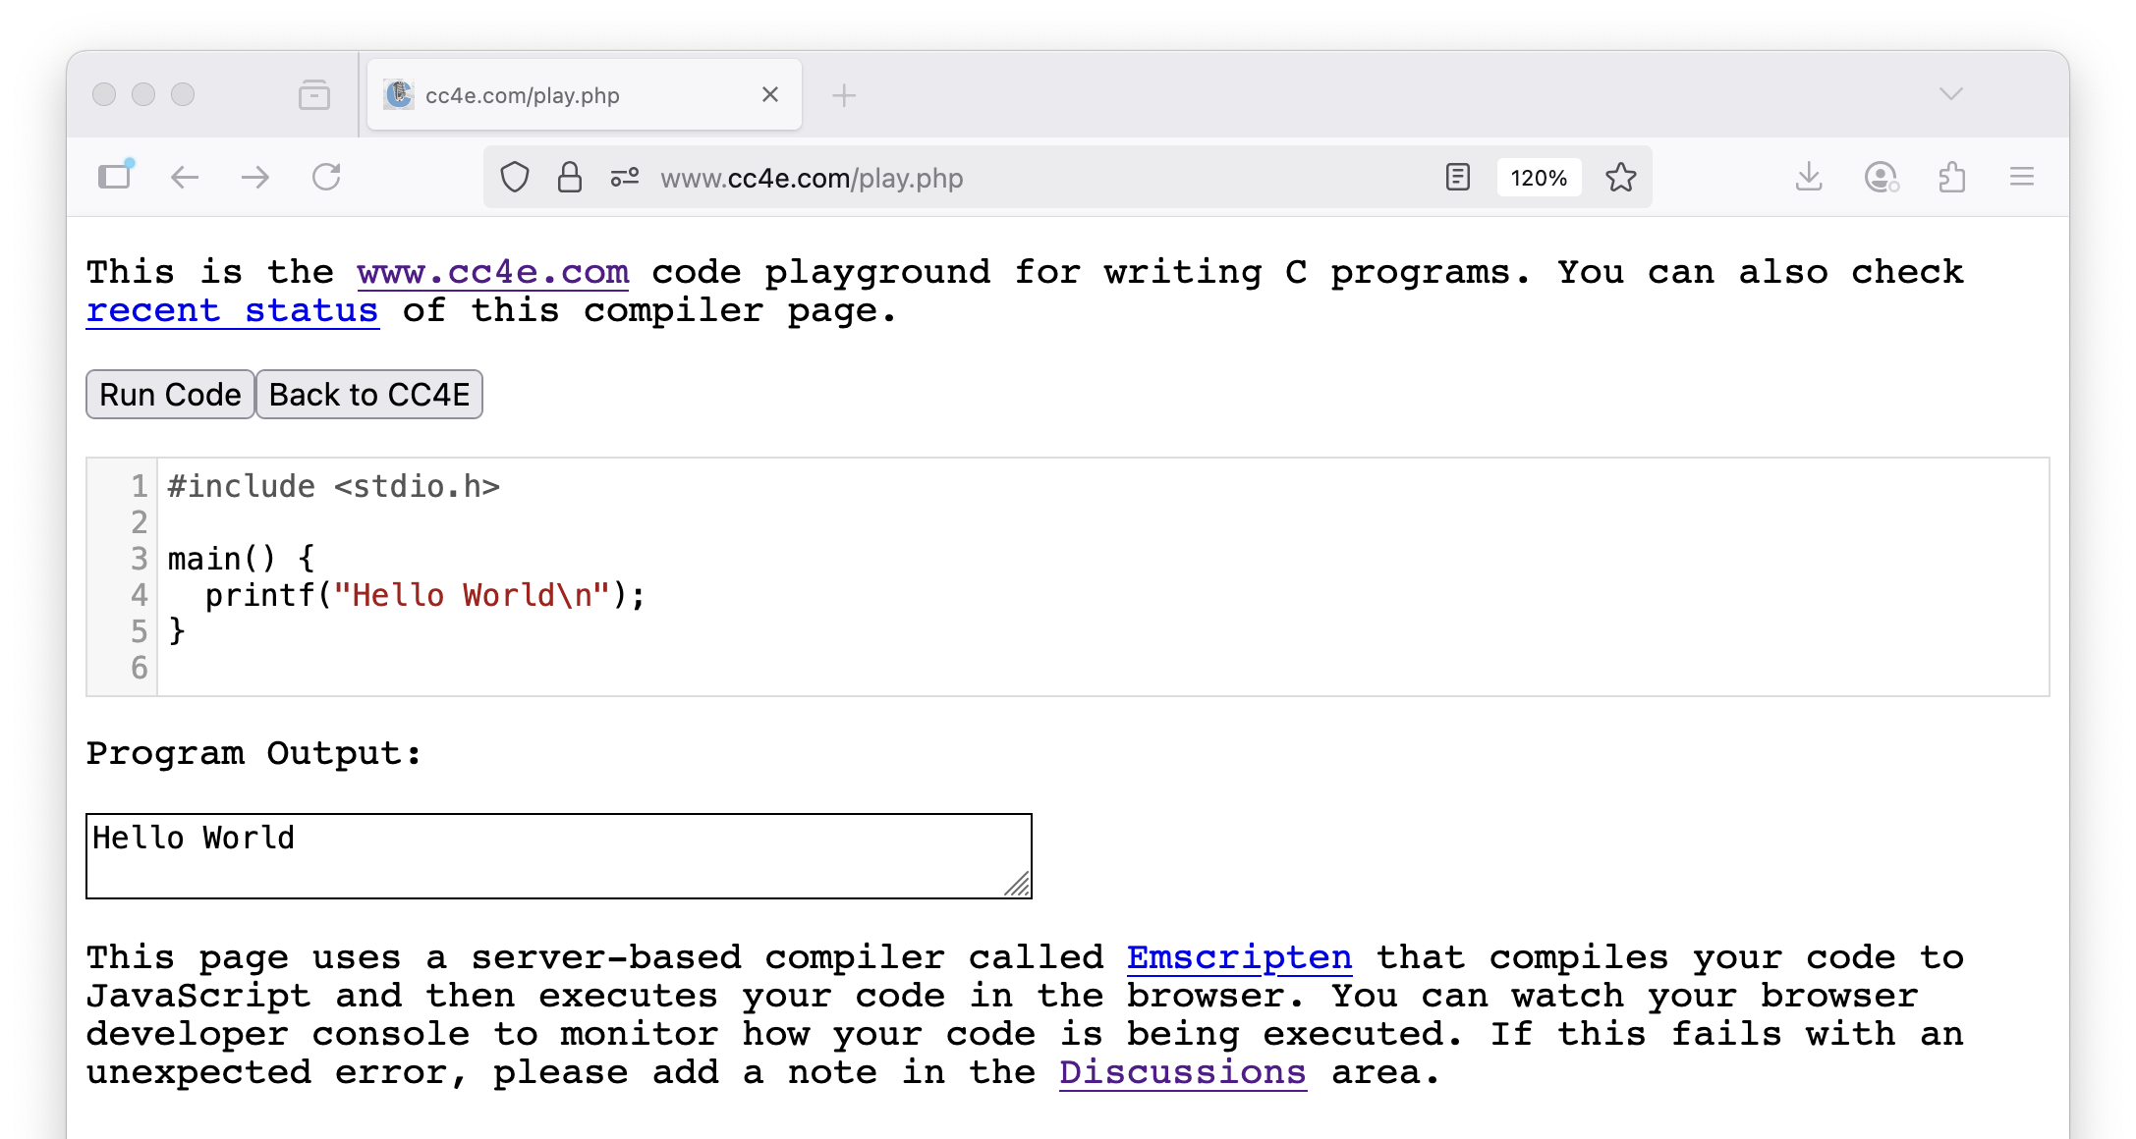

Slide 45
Summary
Fetch-Decode-Execute (a.k.a. Fetch-Execute-Cycle)
Look at the Intel x86 and ARM processor families
Explored the CDC8512 architecture, instruction set, assembly and machine languages
Explored an increasing use of in-browser emulators for games and other applications
Looked at CPU Evolution over time
Looked back at the Intel 4004
Looked forward at Web Assembly (WASM)

Slide 46
Acknowledgements / Contributions
These slides are Copyright 2025- Charles R. Severance (online.dr-chuck.com) as part of www.ca4e.com and made available under a Creative Commons Attribution 4.0 License. Please maintain this last slide in all copies of the document to comply with the attribution requirements of the license. If you make a change, feel free to add your name and organization to the list of contributors on this page as you republish the materials.
Initial Development: Charles Severance, University of Michigan School of Information
Insert new Contributors and Translators here including names and dates
Continue new Contributors and Translators here

